Slide 1
BCSE 0101: Digital Image Processing
|| Shri Hari ||
Prof. Charul Bhatnagar
Room no. 325, AB - I
Email: charul@gla.ac.in
WA no.: 7055510537

Slide 2
Module I
Introduction and Fundamentals: Motivation and Perspective, Applications, Components of Image Processing System, Element of Visual Perception, A Simple Image Model, Sampling and Quantization, Some Basic Relationships between Pixels.
Intensity Transformations and Spatial Filtering: Introduction, Some Basic Intensity Transformation Functions, Histogram Processing, Histogram Equalization, Histogram Specification, Local Enhancement, Enhancement using Arithmetic/Logic Operations – Image Subtraction, Image Averaging, Basics of Spatial Filtering, Smoothing - Mean Filter, Order Statistics Filters, Sharpening – The Laplacian.
Filtering in the Frequency Domain: Fourier Transform and the Frequency Domain, Basis of Filtering in Frequency Domain

Slide 3
Introduction and Fundamentals

Slide 4
Life started on earth about 3.7 billion years ago Can you think of what big thing happened about 555 million years ago?
A major portion of the information received by a human from the environment is visual
The animals got eyes !!
Notes:
Early days of computing, data was numerical.
Later, textual data became more common.
Today, many other forms of data exist: voice, music, speech, images, computer graphics, etc
Each of these types of data are signals.
Loosely defined, a signal is a function that conveys information.

Slide 5
The process of receiving & analyzing visual information by digital computer is called Digital Image Processing
More specifically, DIP is
Improvement of pictorial information for human interpretation.
Processing of image data for storage, transmission, and representation for autonomous machine perception.

Slide 6
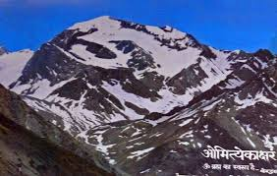
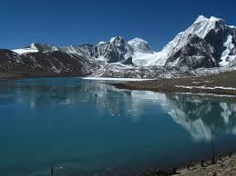

A picture is worth a thousand words.
Notes:
Gurudongmar Lake at a height of 17100 ft, is among the top 15 highest lakes in the world and is the second highest lake in Sikkim as well as in India, the first being Cholamu lake at a height of 18000 ft, also situated in Sikkim. the panoramic and scenic beauty of the place is a sight to behold. Named after Guru Dongmar, the lake has a religious appeal. The beauty of the lake is awesome and out of the world spectacle. Surrounded by snow clad mountains and crystal clear icy water, it is considered to be a very sacred lake.
Legend has it that, Guru Padmasambhava (also known as Guru Dongmar), touched and sanctified the lake, and thus, even in extreme winter, a portion of the lake does not freeze. The lake is also one of the sources of River Teesta, which flows through Sikkim, West Bengal and Bangladesh to merge with the Bay of Bengal.
The water of Gurudongmar Lake are said to have curative properties and many tourists carry the water with them on their way back.

Slide 7
The continuum from image processing to computer vision can be broken up into low-, mid- and high-level processes
Low Level Process
Mid Level Process
High Level Process
Input: Image Output: Image
Examples: Noise removal, image sharpening
Input: Image Output: Attributes
Examples: Object recognition, segmentation
Input: Attributes Output: Understanding
Examples: Scene understanding, autonomous navigation
In this course we will stop here
Notes:
Give the analogy of the character recognition system.
Low Level: Cleaning up the image of some text
Mid level: Segmenting the text from the background and recognising individual characters
High level: Understanding what the text says

Slide 8

DIP has a broad spectrum of applications
Remote sensing via satellites & other spacecrafts
Radar, sonar & acoustic image processing
Medical processing
Image transmission & storage for business applications
Automated inspection of industrial parts
Notes:
Images frm satellite useful in tracking earth resources; prediction of weather, agricultural crops;
Image Xmission & storage- occurs in broadcast TV, teleconferencing, FAX, CCTV based security monitoring syss, military comm.s.
Medical applications – X-rays, nuclear magnetic resonance, ultrasound etc. Computer procedures enhance the contrast or code the intensity levels into color for easier interpretation of Xrays & other biomedical images.
Image enhancement & restoration processes r used to process degraded images of unrecoverable objects or experimental results too expensive to duplicate.
In physics, comp tech routinely enhance images of experiments in areas sa high-energy plasma & electron microscope.

Slide 9
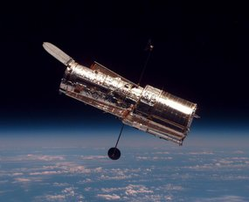
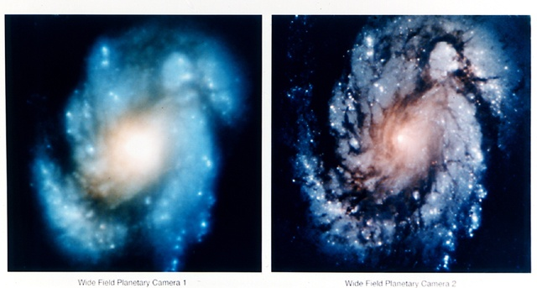
The Hubble Telescope
Launched in 1990 the Hubble telescope can take images of very distant objects
However, an incorrect mirror made many of Hubble’s images useless
Image processing techniques were used to fix this

Slide 10
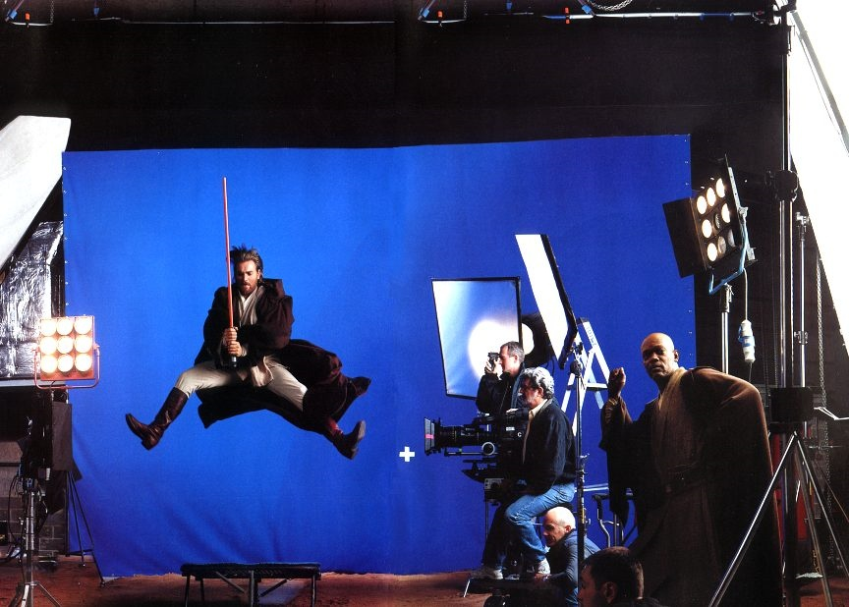
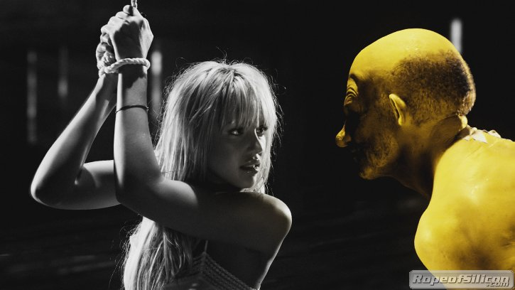


Artistic Effects
Artistic effects are used to make images more visually appealing, to add special effects and to make composite images

Slide 11
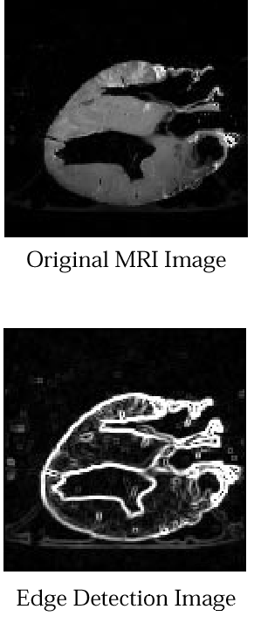
Medicine
Take slice from MRI scan of canine heart, and find boundaries between types of tissue
Image with gray levels representing tissue density
Use a suitable filter to highlight edges
Original MRI Image of a Dog Heart
Edge Detection Image

Slide 12
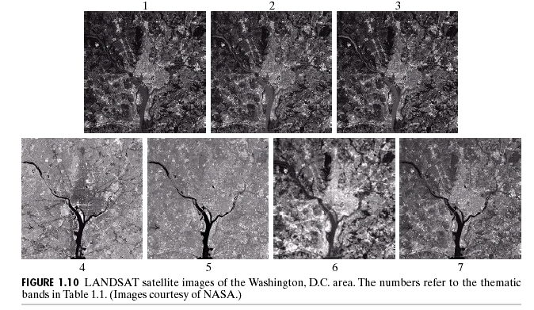
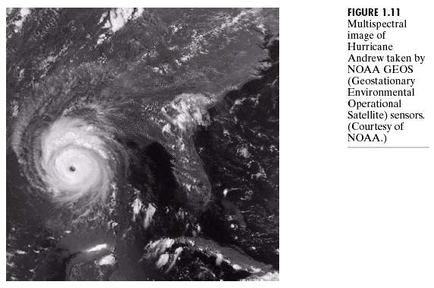
Geographic Information Systems
Digital image processing techniques are used extensively to manipulate satellite imagery
Terrain classification
Meteorology

Slide 13
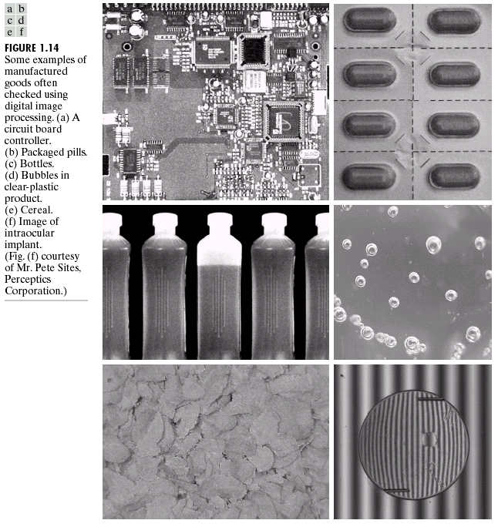
Industrial Inspection
Human operators are expensive, slow and unreliable
Industrial vision systems are used in all kinds of industries

Slide 14
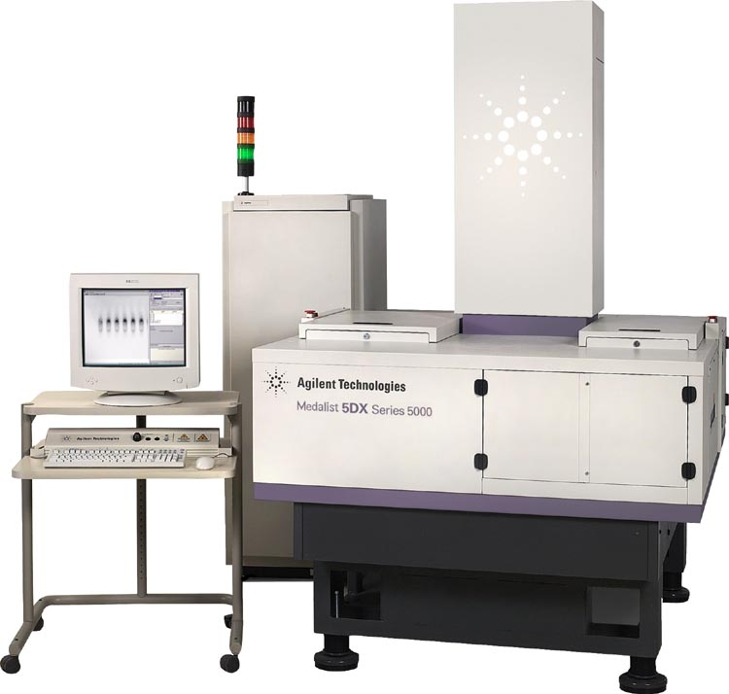
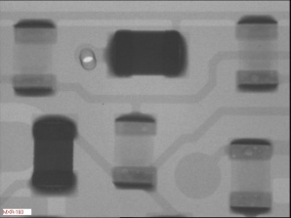
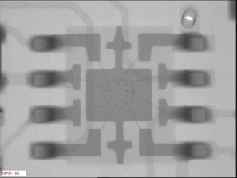
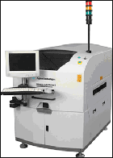
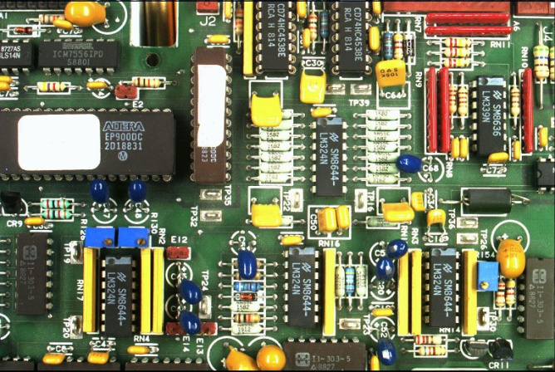
PCB Inspection
Printed Circuit Board (PCB) inspection
Machine inspection is used to determine that all components are present and that all solder joints are acceptable
Both conventional imaging and x-ray imaging are used

Slide 15
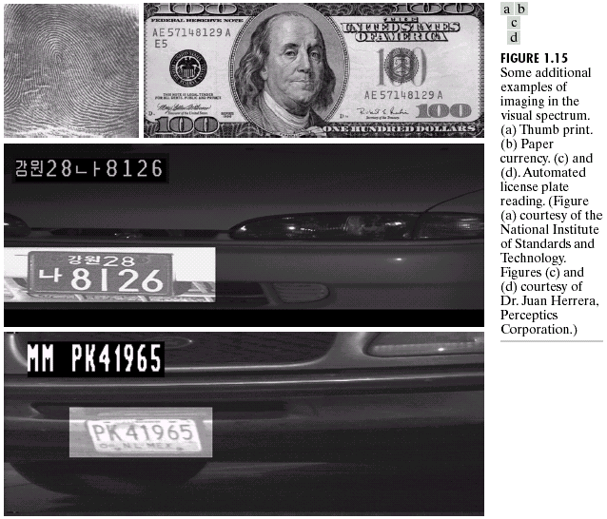
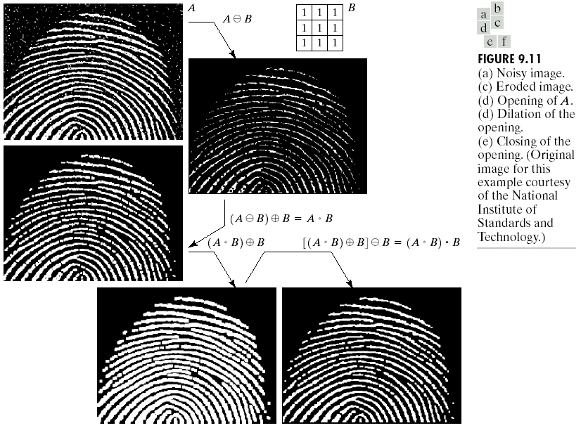
Law Enforcement
Image processing techniques are used extensively by law enforcers
Number plate recognition for speed cameras/automated toll systems
Fingerprint recognition
Enhancement of CCTV images

Slide 16
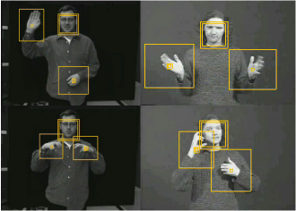
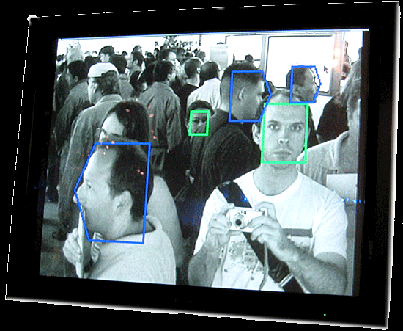
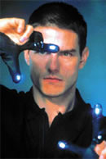
HCI
Try to make human computer interfaces more natural
Face recognition
Gesture recognition
These tasks can be extremely difficult
Notes:
L 1

Slide 17
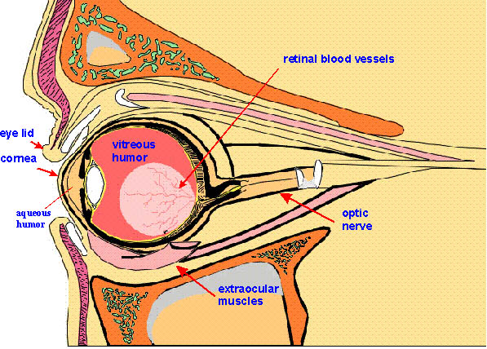
Elements of Visual Perception

Slide 18

DIP
Mathematical
Probabilistic
Formulations
However, the choice of technique is often based on subjective, visual judgment
Hence, understanding Human Visual Perception VERY IMPORTANT !!!
Notes:
DIP is built on the foundations of …

Slide 19
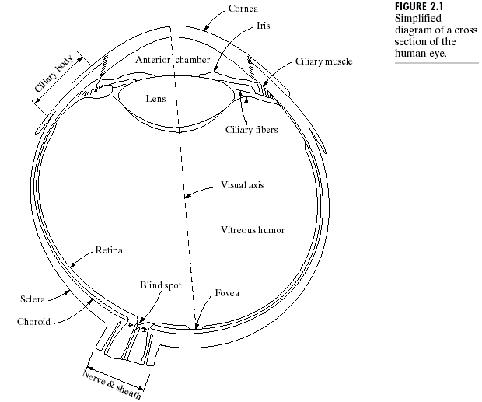
Human Visual Perception
Avg diameter : 20mm
3 membranes enclose the eye
Cornea & sclera
Choroid
Retina
Cross Section of Human Eye

Slide 20
1. Cornea & Sclera
Cornea
Tough & Transparent tissue
Covers the anterior surface of the eye
Sclera
Continuous with cornea
Opaque membrane
Encloses the remainder of the optic globe

Slide 21
2. Choroid
Choroid contains blood vessels for eye nutrition; it is heavily pigmented to reduce extraneous light entrance and backscatter.
Divided into the ciliary body & the iris diaphragm, which controls the amount of light that enters the pupil (2 mm ~ 8 mm).
Lens made up of fibrous cells & is suspended by fibers that attach it to the ciliary body.
It is slightly yellow and absorbs approx. 8% of the visible light spectrum.

Slide 22
3. Retina
Light from an object is imaged on the retina
The retina lines the entire posterior portion.
Discrete light receptors are distributed over the surface of the retina:
cones (6-7 million per eye) and
rods (75-150 million per eye)

Slide 23
Cones
Cones are located in the fovea and are sensitive to color.
Each one is connected to its own nerve end.
Cone vision is called photopic (or bright-light vision).
Muscles controlling the eye rotate the eye ball until the image of an object of interest falls on the fovea.

Slide 24
Rods
Rods are distributed over the retinal surface
Rods give a general, overall picture of the field of view and are not involved in color vision.
Several rods are connected to a single nerve and are sensitive to low levels of illumination (scotopic or dim-light vision).
Objects seen by moon light appear as colourless forms because only rods are stimulated.
Notes:
No receptors in the blind spot

Slide 25

Blind-Spot Experiment
Draw an image similar to that below on a piece of paper (the dot and cross are about 6 inches apart)
Close your right eye and focus on the cross with your left eye
Hold the image about 20 inches away from your face and move it slowly towards you
The dot should disappear!

Slide 26
Image formation in the Eye
The range of focal lengths is approximately 14 mm to 17 mm, the latter taking place when the eye is relaxed and focused at distances greater than about 3 m
Retinal image is reflected primarily in the fovea. Perception takes place by relative excitation of light receptors
Receptors transform radiant energy into electrical impulses which are decoded by the brain

Slide 27
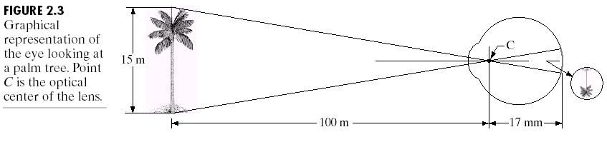
Size of retinal image (h)
15 / 100 = h / 17
h = 2.55 mm
Notes:
Similar triangles – ratio of side/altitude

Slide 28
Brightness Adaptation & Discrimination
Range of light intensity levels to which human visual system (HVS) can adapt of the order of 10¹⁰
Scotopic threshold
Glare Limit
Subjective brightness (i.e. intensity as perceived by the HVS) is a logarithmic function of the light intensity incident on the eye.

Slide 29
Range of adaptable light intensity levels - 10¹⁰
The HVS cannot operate over such a range simultaneously
Accomplishes this large variation by changing its overall sensitivity, a phenomenon known as brightness adaptation.
The total range of distinct intensity levels the eye can discriminate simultaneously is rather small
Notes:
For a given set of conditions, the current sensitivity level of the visual system is called the brightness adaptation level

Slide 30
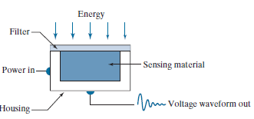

Image Acquisition
Line Sensor
Single sensing element.
E.g. photodiode, whose output is a voltage proportional to light intensity.
Array Sensor
Notes:
Gonzalez 4e Pg 59

Slide 31
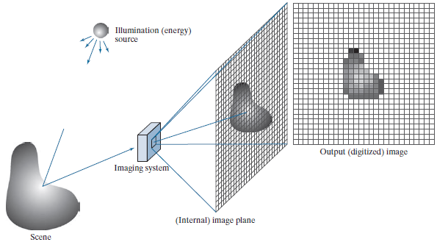
A SIMPLE IMAGE FORMATION MODEL
Notes:
The value of f at spatial coordinates (x, y) is a scalar quantity whose
physical meaning is determined by the source of the image, and whose values are
proportional to energy radiated by a physical source (e.g., electromagnetic waves).
As a consequence, f (x, y) must be nonnegative† and finite

Slide 32
Function f(x, y)
Characterized by two components:
Illumination i(x, y) - the amount of source illumination incident on the scene being viewed, and
Reflectance r(x, y) - the amount of illumination reflected by the objects in the scene.
The two functions combine as a product to form f (x, y)
f (x, y) = i(x, y)r(x, y)
where
0 ≤ i(x, y) < ∞
0 ≤ r(x, y) ≤ 1
Notes:
Thus, reflectance is bounded by 0 (total absorption) and 1 (total reflectance).
The nature of i(x, y) is determined by the illumination source, and
r(x, y) is determined by the characteristics of the imaged objects.

Slide 33
Typical values of i(x, y)
On a sunny day, illumination on earth’s surface is 90,000 lm/m²
On a cloudy day it is 10,000 lm/m²
Full moon yields 0.01 lm/m²
Commercial office yields 1000 lm/m²
Typical values of r(x, y)
for black velvet – 0.01
Stainless steel – 0.65
Flat white wall paint – 0.90
Snow – 0.93
Notes:
The lumen (symbol: lm) is the SI derived unit of luminous flux, a measure of the total quantity of visible light emitted by a source per unit of time.

Slide 34
Digital Image Representation
Gray scale images can be represented as a function of two variables, f(x, y), where f(x, y) is the brightness (or grayness or intensity) of the image at the coordinate (x, y)
In colour image, the intensity is measured in 3 wavelengths (red, green, blue), so
f(x, y) = [f_{R}(x, y), f_{G}(x, y), f_{B}(x, y)].

Slide 35
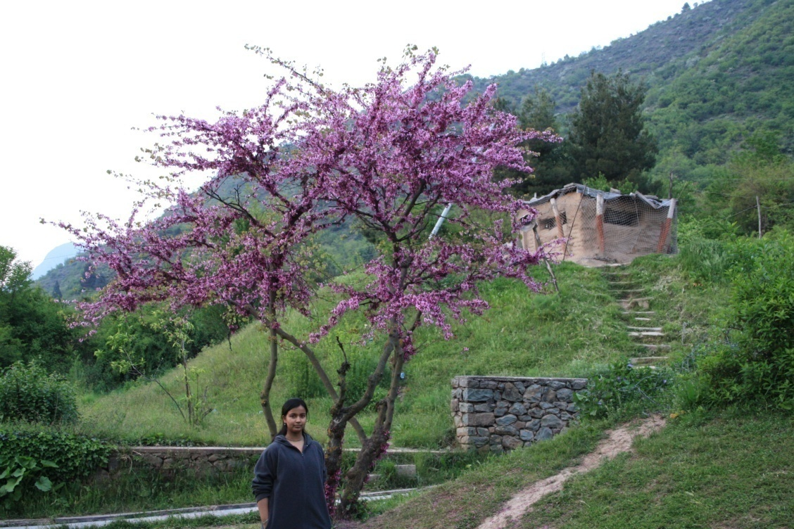
Digital image is a representation of a two-dimensional image using ones and zeros (binary).
00000000 01110010 01100100 …
00011001 01000010 01100101 …
00011111 00110010 01100101 …
00000000 01110010 01100100 …
00011001 01000010 01100101 …
00011111 00110010 01100101 …
00000000 01110010 01100100 …
00011001 01000010 01100101 …
00011111 00110010 01100101 …
00000000 01110010 01100100 …
00011001 01000010 01100101 …
00011111 00110010 01100101 …
…
.
.
.
.
.
What we see
What the computer sees!!!

Slide 36
Image Sampling & Quantization
Numerous ways to acquire images
o/p of most sensors is a continuous voltage waveform whose amplitude & spatial behaviour are related to the physical phenomenon (e.g. brightness) being sensed.
For an image to be processed by a computer, it must be represented by an appropriate discrete data structure (e.g. Matrix)
Two important processes to convert continuous analog image into digital image – Sampling & Quantization

Slide 37
Discretization
Process in which signals or data samples are considered at regular intervals.
Sampling
It is the discretization of image data in spatial coordinates.
Quantization
It is the discretization of image intensity (gray level) values.

Slide 38
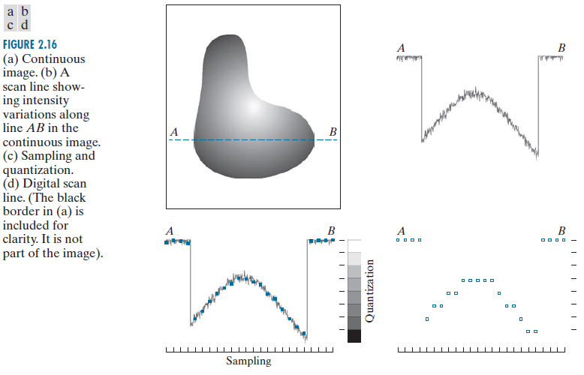

Slide 39
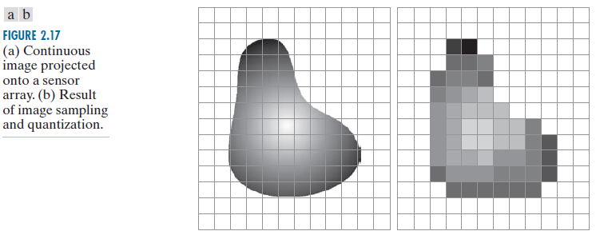

Slide 40

origin
y
A digital image is an image f(x, y) that has been discretized in both spatial coordinates & brightness.
f(x, y)
x
A digital image can be considered as a matrix, where the matrix element value identifies the gray level at that point.
Notes:
Gonzalez, Woods
we define the origin of an image at the top left corner. This is a convention based on the fact that many image displays (e.g., TV monitors) sweep an image starting at the top left and moving to the right, one row at a time.
More important is the fact that the first element of a matrix is by convention at the top left of the array. Choosing the origin of f (x, y) at that point makes sense mathematically because digital images in reality are matrices.

Slide 41
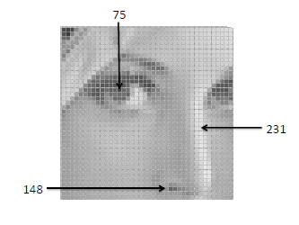
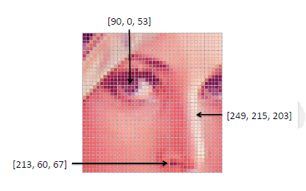
Pixels
An image contains discrete number of pixels
Pixel value:
“grayscale” (or “intensity”): [0,255]
“color”
– RGB: [R, G, B]
– Lab: [L, a, b]
– HSV: [H, S, V]

Slide 42
f( x, y ) gives the intensity at position ( x, y )
For digital images M, N and L (no. of gray levels) are mostly considered as powers of 2. Suppose M = 2⁹ , N = 2¹⁰ & L = 2^{k} = 2⁸
Total number of bits b required to represent an image???
b = 512 x 1024 x 8 = 41,94,304 bits
Notes:
The number, b, of bits required to store a digital image is b = M * N * k
When M = N, this equation becomes b = N²k

Slide 43
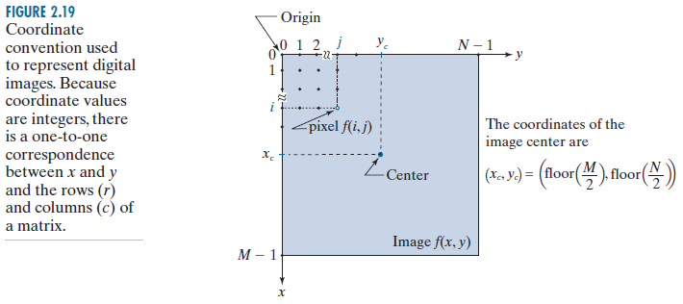
Coordinates of the Centre of the Image?
Notes:
Some programming languages (e.g., MATLAB) start indexing at 1 instead of at 0. The center of an image in that case is found at
(x_{c} , y_{c} ) = (floor (M/2 )+ 1 ), (floor (N/2) + 1)

Slide 44
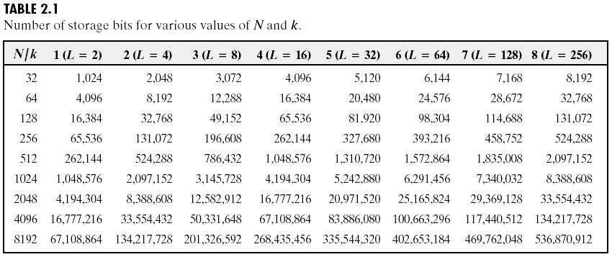
k-bit image An image having 2^{k} gray levels
8-bit image
An image having 256 gray levels is called a
b = N² k
8-bit images of size 1024 x 1024 or higher Storage Requirement Not Insignificant !!!!

Slide 45
The intensity of a monochrome image at any coordinate (x, y) is called the gray level (l ) of the image at that point
l = f(x, y)
Gray Scale
[L_{min} , L_{max} ]
L_{min} ≤ l ≤ L_{max}
_{Common Practice}
Shift the interval numerically to the interval [0, L-1].
_{l = 0 is considered black &}
l = L-1 is considered white on the gray scale.
All intermediate values are shades of gray varying from black to white.
Notes:
Interval is called gray scale
L 02

Slide 46
Resolution of an Image
Spatial Resolution
It is the smallest discernible detail in an image
Gray-level Resolution
It is the smallest discernible change in the gray level of an image.
L-level digital image of size M x N
Spatial resolution – M x N pixels
Gray-level resolution – L levels

Slide 47



Dots per inch (dpi)
E.g. newspapers are printed with a resolution of 75 dpi, magazines at 133 dpi, glossy brochures at 175 dpi
Pixels per inch (PPI)
200 x 200
100 x 100
50 x 50
25 x 25
Measuring Spatial Resolution
Notes:
To say that an image has a resolution of 1024 * 1024 pixels is not a meaningful statement without stating the spatial dimensions encompassed by the image.
Size by itself is helpful only in making comparisons between imaging capabilities. For instance, a digital camera with a 20-megapixel CCD imaging chip can be expected to have a higher capability to resolve detail than an 8-megapixel camera, assuming that both cameras are equipped with comparable lenses and the comparison images are taken at the same distance.

Slide 48

Samsung Galaxy S22 Ultra
Expected Launch in India: Feb 2022
What does it mean?

Slide 49
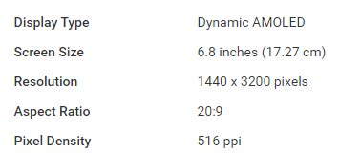
Samsung Galaxy S22 Ultra
Expected Launch in India: Feb 2022
What is meant by Screen size?
Pixels per inch along the diagonal?
How many pixels along the diagonal of the screen?

Slide 50
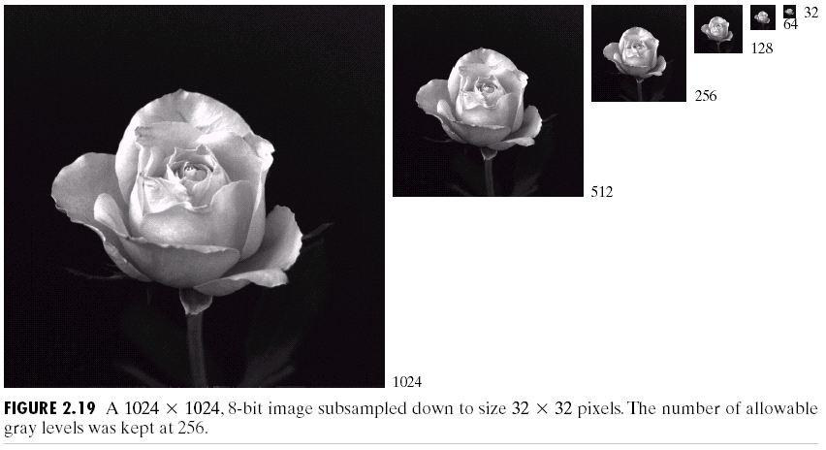
Fixed Gray-level Varying number of samples
Notes:
Subsampling done by deleting appropriate no. of rows & columns.
e.g. 512x512 image was obtained by deleting every other row & col of 1024x1024 image.

Slide 51
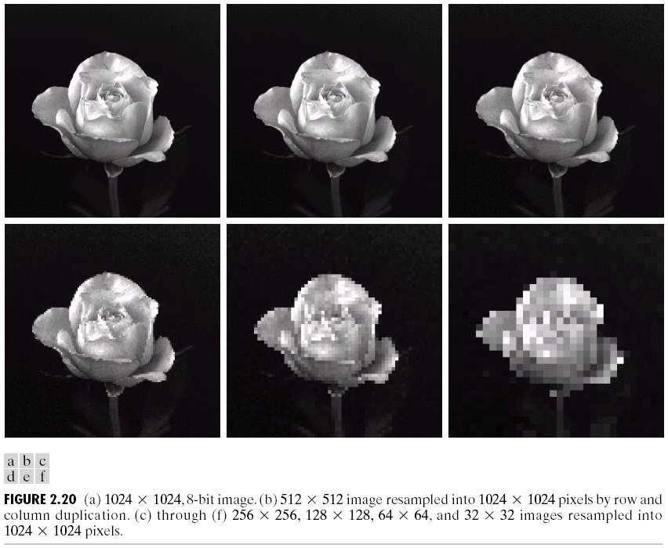
& (b) virtually impossible to tell apart. The level of detail lost is too fine.
(c)
V slight fine checkerboard pattern in the borders & some graininess throughout the image
(d), (e), (f)
These effects much more visible.

Slide 52
Checkerboard Effect
When the no. of pixels in an image is reduced keeping the no. of gray levels in the image constant, fine checkerboard patterns are found at the edges of the image. This effect is called the checker board effect.

Slide 53
Common practice to refer to the number of bits used to quantize intensity as the “intensity resolution.”
For example, it is common to say that an image whose intensity is quantized into 256 levels has 8 bits of intensity resolution.
Measuring Gray Level Resolution

Slide 54
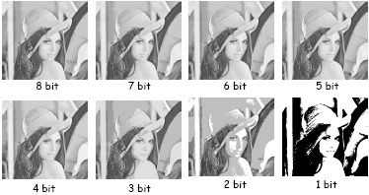
Varying Gray-level Fixed number of samples

Slide 55
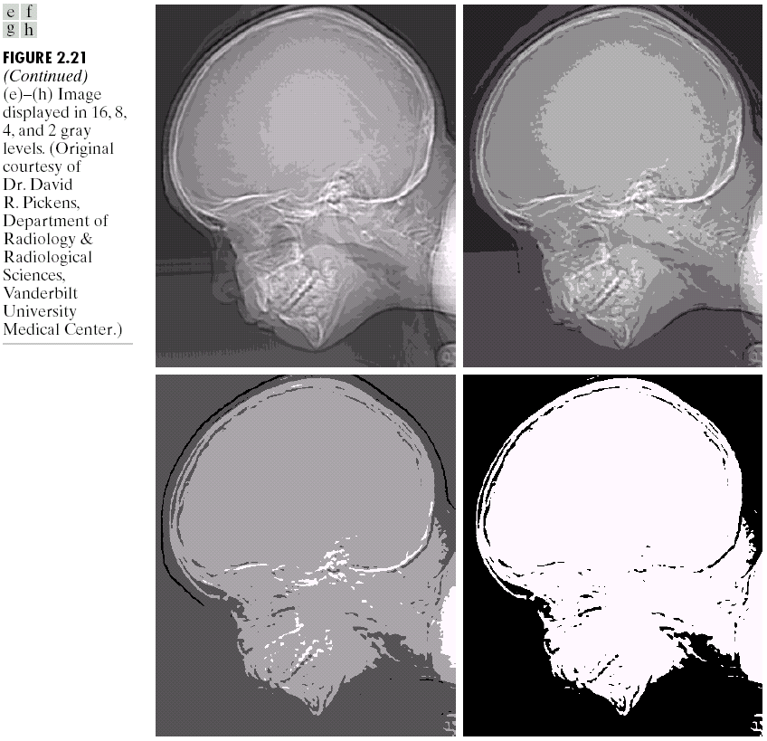
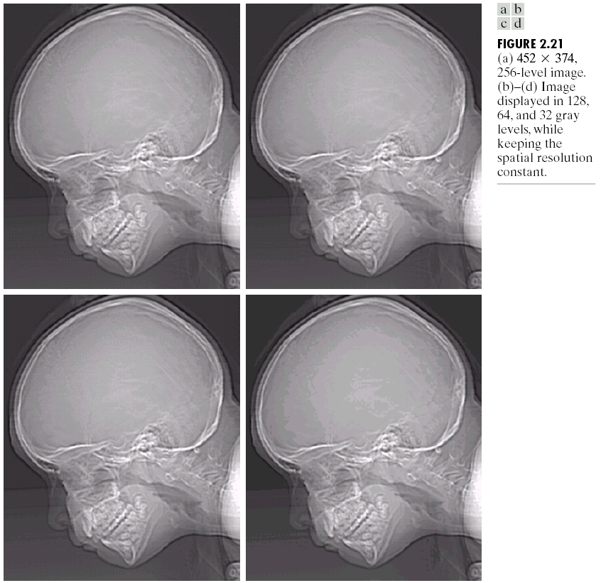
False contouring

Slide 56
When the no. of gray-levels in the image is low, the foreground details of the image merge with the background details of the image, causing ridge like structures.This degradation phenomenon is known as false contouring.
(The ridges resemble topographic contours in a map)
False Contouring

Slide 57
Baud rate
A common measure of transmission for digital data. It is the no. of bits transmitted per second.
Q) Generally transmission is accomplished in packets consisting of a start bit, a byte of information & a stop bit.
How many minutes would it take to transmit a 1024 x 1024 image with 256 gray levels using a 56K baud rate?

Slide 58
Total no. of bits needed to represent the image:
1024 x 1024 x 8
No. of packets required :
1024 x 1024
Total no. of bits that need to be transferred:
1024 x 1024 x [8 + 2]
Total time required to transmit over 56K baud modem:
1024 x 1024 x 10
56000
= 187.25 sec or 3.1 min
Notes:
256 gray levels → 8 bits needed

Slide 59
SOME BASIC RELATIONSHIPS BETWEEN PIXELS

Slide 60
Neighbours of a Pixel
NW N NE
W X E
SW S SE
X₃ X₂ X₁
X₄ p X₀
X₅ X₆ X₇
N₄ (p)
Pixel p at coordinates (x, y) has 4 horizontal & vertical neighbours.
(x-1, y) (x+1, y) (x, y-1) (x, y+1)
N_{D} (p)
Pixel p at coordinates (x, y) has 4 diagonal neighbours.
(x-1, y-1) (x+1, y-1) (x-1, y+1) (x+1, y+1)

Slide 61
N₄(p) N_{D}(p) N₈(p)
If pixel p lies on the boundary, then some of the neighbours of p will lie outside the digital image.
The set of image locations of the neighbors of a point p is called the neighborhood of p.
The neighborhood is said to be closed if it contains p.
Otherwise, the neighborhood is said to be open.

Slide 62
Adjacency
V The set of gray-level values used to define adjacency
In a gray-scale image, V typically contains more than one elements. E.g. in an image of 265 gray-levels, V could be any subset of these 256 values.
In a binary image, V = {1} for finding the adjacency of a pixel with value 1.

Slide 63
Types of Adjacency
I) 4-adjacency
Two pixels p & q with values from V are 4-adjacent if q is in the set N₄(p).
II) 8-adjacency
Two pixels p & q with values from V are 8-adjacent if q is in the set N₈(p).

Slide 64
III) m-adjacency (mixed adjacency)
Two pixels p & q with values from V are m-adjacent if
q is in the set N₄(p), or
q is in N_{D}(p) and the set N₄(p) ∩ N₄(q) has no pixels whose values are from V.
Mixed adjacency is a modification of 8-adjacency. It is used to eliminate ambiguities that may arise when 8-adjacency is used.

Slide 65
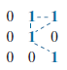
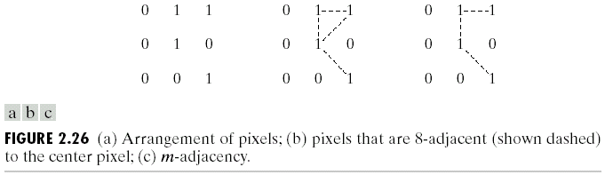
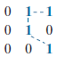
8 adjacency
Find 8-adjacency and m-adjacency of the pixel in the centre.
Note: V = {1}
m - adjacency

Slide 66
Path can be 4-, 8- or m-path, depending upon the type of adjacency specified.
Path between NE & SE pixels
8-path shown in (b) & m-path shown in (c)
Note: No ambiguity in m-path

Slide 67
Digital Path or Curve
From pixel p with coordinates (x₀, y₀) to pixel q with coordinates (x_{n}, y_{n})
(x₀, y₀), (x₁, y₁), …, (x_{n}, y_{n})
where pixels (x_{i}, y_{i}) & (x_{i-1}, y_{i-1}) are adjacent for 1 ≤ i ≤ n
n is the length of the path
If (x₀, y₀) = (x_{n}, y_{n}) then the path is closed
Notes:
L 4

Slide 68
Connected in S
S – subset of pixels in an image.
Pixels p & q are said to be connected in S, if there exists a path between them consisting entirely of pixels in S.
For any pixel p in S, the set of pixels that are connected to it in S, is called the connected component of S.
If S has only one connected component, then S is called a connected set.

Slide 69
Region
R – subset of pixels in an image.
R is a region of an image if R is a connected set
R_{i} & R_{j} are adjacent if their union forms a connected set; otherwise the regions are said to be disjoint.
1 | 1 | 0 | 0 | 1 | 1
1 | 1 | 0 | 1 | 0 | 1
1 | 1 | 1 | 0 | 1 | 1
Are the two regions adjacent?
Notes:
8 adjacent but not 4 adjacent

Slide 70
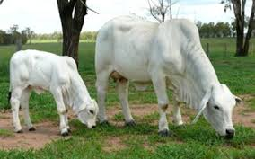
Suppose an image contains K disjoint regions, R_{k} , k =1, 2,…, K, none of which touches the image border.
Let R_{u} denote the union of all the K regions.
Let (R_{u})^{C} denote its complement
We call all the points in R_{u} the foreground, and all the points in (R_{u})^{C} the background of the image.
Notes:
none of which touches the image border - We make this assumption to avoid having to deal with special cases. This can be done without loss of generality because if one or more regions touch the border of an image, we can simply pad the image with a 1-pixel-wide border of background values.

Slide 71
Boundary
The boundary (aka border or contour) of a region R is the set of pixels in R that have one or more neighbours that are not in R.
If R happens to be an entire image, then its boundary is defined as the set of pixels in the first and last rows and columns of the image.
0 | 0 | 0 | 0 | 0
0 | 1 | 1 | 0 | 0
0 | 1 | 1 | 0 | 0
0 | 1 | 1 | 1 | 0
0 | 1 | 1 | 1 | 0
0 | 0 | 0 | 0 | 0
Is it a boundary pixel?
Notes:
It is a boundary pixel if 8 adjacency is taken; not for 4 adjacency.
Here again, we must specify the connectivity being used to define adjacency.

Slide 72
Boundary another definition
Inner border of the region - set of pixels in R that are adjacent to pixels in the complement of R.
Outer border - which is the corresponding border in the background.
This distinction is important in the development of border-following algorithms. Such algorithms usually are formulated to follow the outer boundary in order to guarantee that the result will form a closed path.
0 | 0 | 0 | 0 | 0
0 | 0 | 1 | 0 | 0
0 | 0 | 1 | 0 | 0
0 | 0 | 1 | 0 | 0
0 | 0 | 1 | 0 | 0
0 | 0 | 0 | 0 | 0
0 | 0 | 0 | 0 | 0
0 | 0 | 1 | 0 | 0
0 | 0 | 1 | 0 | 0
0 | 0 | 1 | 0 | 0
0 | 0 | 1 | 0 | 0
0 | 0 | 0 | 0 | 0
Notes:
For instance, the inner border of the 1-valued region is the region itself. This border does not satisfy the definition of a closed path.
On the other hand, the outer border of the region does form a closed path around the region.

Slide 73
Edge vs Boundary
Boundary of a region forms a closed path
“Global Concept”
Edges are formed from pixels with derivative values that exceed a preset threshold. It is thus a local concept that is based on a measure of intensity-level discontinuity at a point.
Notes:
It is possible to link edge points into edge segments, and sometimes these segments are linked in such a way that they correspond to boundaries, but this is not always the case.

Slide 74
Distance Measures
Pixel | Coordinate
p | (x, y)
q | (s, t)
Euclidean distance between p & q
D_{e}(p, q) = [ (x – s)² + (y – t)²]^{1/2}
City-block distance between p & q
D₄(p, q) = |x – s| + |y – t|
Chessboard distance between p & q
D₈(p, q) = max(|x – s| , |y – t|)

Slide 75
What will be the shape of the figure which consists of all pixels which are at a distance of ≤ 3 from pixel (3, 3), when the distance measure is
Euclidean ?
City block ?
Chessboard ?
 |  |  | (3,3)

Slide 76
 | 0 | 1 | 2 | 3 | 4 | 5 | 6
0 | (0, 0)
1
2
3 |  |  |  | (3,3)
4
5
6

Slide 77
 |  |  | 3.0
 | 2.8 | 2.2 | 2.0 | 2.2 | 2.8
 | 2.2 | 2.0 | 1.0 | 2.0 | 2.2
3.0 | 2.0 | 1.0 | 0.0 | 1.0 | 2.0 | 3.0
 | 2.2 | 2.0 | 1.0 | 2.0 | 2.2
 | 2.8 | 2.2 | 2.0 | 2.2 | 2.8
 |  |  | 3.0
Euclidean Distance
Disk shape

Slide 78
 |  |  | 3.0
 |  | 3.0 | 2.0 | 3.0
 | 3.0 | 2.0 | 1.0 | 2.0 | 3.0
3.0 | 2.0 | 1.0 | 0.0 | 1.0 | 2.0 | 3.0
 | 3.0 | 2.0 | 1.0 | 2.0 | 3.0
 |  | 3.0 | 2.0 | 3.0
 |  |  | 3.0
City-block Distance
Diamond shape

Slide 79
3.0 | 3.0 | 3.0 | 3.0 | 3.0 | 3.0 | 3.0
3.0 | 2.0 | 2.0 | 2.0 | 2.0 | 2.0 | 3.0
3.0 | 2.0 | 1.0 | 1.0 | 1.0 | 2.0 | 3.0
3.0 | 2.0 | 1.0 | 0.0 | 1.0 | 2.0 | 3.0
3.0 | 2.0 | 1.0 | 1.0 | 1.0 | 2.0 | 3.0
3.0 | 2.0 | 2.0 | 2.0 | 2.0 | 2.0 | 3.0
3.0 | 3.0 | 3.0 | 3.0 | 3.0 | 3.0 | 3.0
Chessboard Distance
Square shape

Slide 80
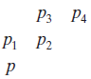
The D₄ and D₈ distances between p and q are independent of any paths that might exist between these points because these distances involve only the coordinates of the points.
In the case of m-adjacency, however, the D_{m} distance between two points is defined as the shortest m-path between the points.
In this case, the distance between two pixels will depend on the values of the pixels along the path, as well as the values of their neighbors.
For instance, consider the following arrangement of pixels and assume that p, p2 , and p4 have a value of 1, and that p1 and p3 are 0
D_{m}(p, p₄) = ?
If value of p₁ = 1
D_{m}(p, p₄) = ?
Notes:
D_{m}(p, p₄) = 2 / 3

Slide 81
Intensity Transformations and Spatial Filtering

Slide 82
We will now see some Image Processing Techniques implemented in Spatial Domain (the plane containing the pixels of an image)
g(x, y) = T[ f (x, y)]
Output Image
Operator on f defined over a neighbourhood of point (x, y)
Input Image

Slide 83
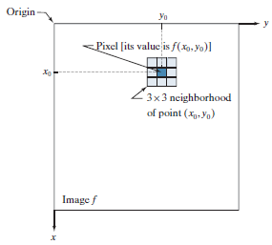
The small region shown is a neighborhood of (x0 , y0 ).
Move the center of the neighborhood (x0 , y0 ), from pixel to pixel, and apply the operator T to the pixels in the neighborhood to yield an output value at that location.
For any specific location (x0 , y0 ), the value of the output image g at those coordinates is equal to the result of applying T to the neighborhood with origin at (x₀ , y₀ ) in f.
The point (x0 , y0 ) is an arbitrary location in the image
Notes:
Typically, the neighborhood is rectangular, centered on (x0 , y0 ), and much smaller in size than the image.

Slide 84
200 | 200 | 200 | 200 | 100
200 | 100 | 100 | 200 | 100
200 | 100 | 100 | 200 | 100
200 | 100 | 200 | 200 | 100
200 | 100 | 100 | 100 | 100
Suppose that the neighborhood is a square of size 3 × 3
Operator T is defined as “compute the average intensity of the pixels in the neighborhood.”
Find g(2, 2)
g(2, 2) = (100 + 100 + 200 + 100 + 100 + 200 + 100 + 200 + 200) / 9
= 144
Notes:
144.44 but we round it to 144 as intensity values are integers
The center of the neighborhood is then moved to the next adjacent location and the procedure is repeated to generate the next value of the output image g. Typically, the process starts at the top left of the input image and proceeds pixel by pixel in a horizontal (vertical) scan, one row (column) at a time.

Slide 85
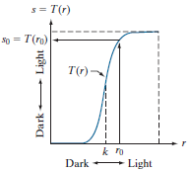
Intensity Transformation Function
(aka called a gray-level, or mapping)
The smallest possible neighborhood is of size 1 × 1.
In this case, g depends only on the value of f at a single point (x, y)
s = T(r)
What is this transformation doing?
Contrast Stretching
Notes:
we use s and r to denote, respectively, the intensity of g and f at any point (x, y).
The result of applying the transformation to every pixel in f to generate the corresponding pixels in g would be to produce an image of higher contrast than the original, by darkening the intensity levels below k and brightening the levels above k. In this technique, sometimes called contrast stretching (see Section 3.2), values of r lower than k reduce (darken) the values of s, toward black. The opposite is true for values of r higher than k. Observe how an intensity value r0 is mapped to obtain the corresponding value s0

Slide 86
Intensity transformations & Spatial filtering have a broad range of applications.
One important application
Image Enhancement
Enhanced, but we are not going to do such enhancements!!
Notes:
L 5

Slide 87
Principal Objective Of
Enhancement
To process an image so that the result is more suitable than the original image for a specific application
Enhance otherwise hidden information
Filter important image features
Discard unimportant image features
Notes:
Specific – coz a method that is useful for enhancing X-ray images, may not necessarily be good for infrared images.
No general theory of image enhancement
• A certain amount of trial and error is usually required before a particular image enhancement approach is selected.

Slide 88
Basic Gray Level Transformations
Amongst the simplest of all image enhancement techniques
s = T(r)
Linear transformations
Image negative
Non-linear transformations
Logarithmic transformation
Power Law (Exponential) transformation
Piecewise-linear transformations
Contrast stretching
Gray-level slicing
Bit plane slicing

Slide 89
1. Image Negatives
Gray levels of the original image in the range of [0, L-1]
Then the negative of an image can be obtained by reversing the intensity levels, the expression for which is given as:
s = L – 1 – r
This type of processing is suited for enhancing white or gray detail embedded in dark regions of an image, especially when black areas are dominant.

Slide 90
Image Negatives
L-1
Output gray level
0
Input gray level
L-1

Slide 91
2. Log Transformations
General form:
s = c log (1 + r)
where c is a constant & r ≥ 0.
Maps a narrow range of low gray levels in the i/p image into wider range of o/p levels.
Opposite is true at higher values of i/p levels.

Slide 92
This type of processing is used to expand the values of dark pixels in an image while compressing the higher level values.
InvLog
Log

Slide 93
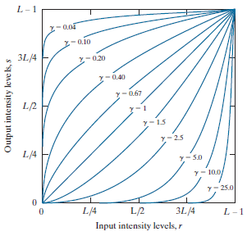
3. PowerLaw (Gamma) Transformations
General form:
s = c r^{γ}
Where c & γ are positive constants.
When γ < 1
map a narrow range of dark i/p values into wider range of o/p values.
Opposite is true for higher i/p values.
When γ > 1
Exactly the opposite effect as those generated with values of γ < 1.
Notes:
For c = γ = 1, it reduces to identity function
When γ < 1 acts as log transformation
When γ > 1 acts opposite to log

Slide 94
Varying gamma (γ) obtains family of possible transformation curves
γ > 1
Compresses dark values
Expands bright values
γ < 1
Expands dark values
Compresses bright values
Notes:
γ = 1 gives identity transformation

Slide 95
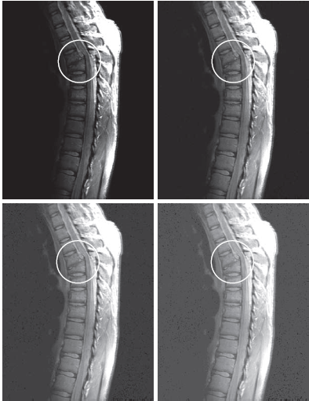
(a) Magnetic resonance image (MRI) of a
fractured human spine (the region
of the fracture is enclosed by the circle).
(b)–(d) Results of applying the Gamma
Transformation with c = 1 and γ = 0.6 , 0.4, and 0.3, respectively.

Slide 96
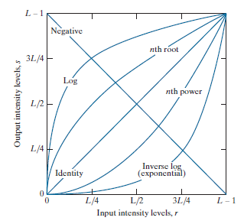
Some basic intensity transformation functions.
Each curve was scaled independently so that all curves would fit in the same graph.
The interest here is on the shapes of the curves, not
on their relative values.

Slide 97
Piecewise-Linear Transformation Functions
A complementary approach to the previous methods
Form of piecewise functions can be arbitrarily complex.
Practical implementation of some important transformations can be formulated only as piecewise functions
Their specification requires considerably more user i/p.

Slide 98
4. Contrast Stretching
Simplest of piecewise linear functions.
Basic idea – to increase the dynamic range of the gray levels in the image being processed.
During image acquisition, low contrast images may result due to
Poor illumination
Lack of dynamic range in image sensor
Wrong setting of the lens aperture
Notes:
L 6

Slide 99
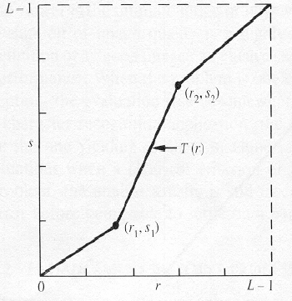
The locations of (r1,s1) and (r2,s2) control the shape of the transformation function
If r1 = s1 and r2 = s2 the transformation is a linear function and produces no changes.
If r1 = r2, s1 = 0 and s2 = L-1, the transformation becomes a thresholding function that creates a binary image.
If r1 = s1 and r2 = s2 ?
If r1 = r2, s1 = 0 and s2 = L-1 ?
Typical transformation function used for contrast stretching

Slide 100
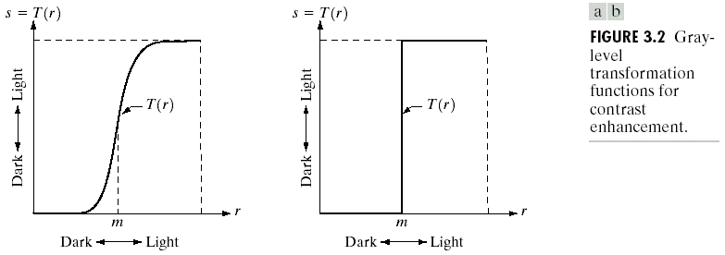
Thresholding Function
m = ‘threshold level’

Slide 101

Contrast stretching.
(a) Piecewise linear
Transformation function.
(b) A low contrast electron
microscope image of pollen, magnified 700 times.
(c) Result of contrast stretching.
(d) Result of thresholding.

Slide 102

5. Gray Level / Intensity-Level Slicing
Used to highlight a specific range of gray values
One way is to display a high value for all gray levels in the range of interest and a low value for all other gray levels
(binary image).
Notes:
Some of these applications include enhancing features in satellite imagery, such as masses of water, and enhancing flaws in X-ray images.

Slide 103

What should we do to brighten the desired range of gray levels and leave all other intensities unchanged?

Slide 104

Aortic angiogram.
Result of using a slicing transformation, with the range of intensities of interest selected in the upper end of the gray scale.
Result of using the transformation with the selected range set near black, so that the grays in the area of the blood vessels and kidneys were preserved.

Slide 105

6. Bit Plane Slicing
Visually significant data
Subtle details
Extracts the information of a single bit plane
Instead of highlighting gray-level ranges, highlighting the contribution made to the total image appearance by specific bits might be desired.
Notes:
Decomposing an image into its bit planes is useful for analyzing the relative importance of each bit in the image, a process that aids in determining the adequacy of the number of bits used to quantize the image. Also, this type of decomposition is useful for image compression

Slide 106


MSB (bit 7)
LSB (bit 0)

Slide 107
Histograms

Slide 108
The histogram of a digital image with grey levels from 0 to L-1 is a discrete function
h(r_{k}) = n_{k}
or for a normalized Histogram it is
where:
r_{k} is the k-th grey level
n_{k} is the no. of pixels in the image with that grey level
M, N are the no. of rows & columns in the image
k = 0, 1, 2, …, L-1
Notes:
Mostly, we work with normalized histograms, which we refer to simply as histograms or image histograms. The sum of p (rk) for all values of k is always 1. The components of p (rk) are estimates of the probabilities of intensity levels occurring in an image.

Slide 109
Histogram
The (intensity or brightness) histogram shows how many times a particular grey level (intensity) appears in an image.
For example, 0 - black, 255 – white
0 | 1 | 1 | 2 | 4
2 | 1 | 0 | 0 | 2
5 | 2 | 0 | 0 | 4
1 | 1 | 2 | 4 | 1
Image
Histogram

Slide 110

Histogram shape is related to image appearance
Four image types and their corresponding histograms. (a) dark; (b) light; (c) low contrast; (d) high contrast. The horizontal axis of the histograms are values of r_{k} and the vertical axis are values of p( r_{k} ).
Notes:
Intuitively, it is reasonable to conclude that an image whose pixels tend to occupy the entire range of possible intensity levels and, in addition, tend to be distributed uniformly, will have an appearance of high contrast and will exhibit a large variety of gray tones. The net effect will be an image that shows a great deal of gray-level detail and has a high dynamic range.

Slide 111
Normalized Histogram
probability of occurrence of intensity level r_{k}
p(r_{k}) = n_{k}/MN
Sum of all components = 1
For example: 8-bit grey-scale image
p(0) = 0.1 10% of pixels are black
p(…) = …
p(128) = 0.05 5% of pixels are med-grey
p(…) = …
p(255) = 0.0 0% white pixels

Slide 112
Are histograms unique ???
Histograms of both the images are same !!

Slide 113
A gray scale transformation for contrast enhancement is usually found automatically using the Histogram equalization technique.
The aim is to create an image with equally distributed brightness levels over the whole brightness scale.

Slide 114
Histogram Equalization
Example:
T
We are looking for
this transformation !
Notes:
The image consists of an equal number of pixels for every gray-value, the histogram is constant !

Slide 115
Histogram Equalization
Let
r - represent the gray levels, with r = 0 representing black & r = L - 1 representing white.
Consider the following transformation function, which produces a level s for every pixel value r in the original image
s = T(r) 0 ≤ r ≤ L - 1

Slide 116

We assume that
T(r) is a monotonic increasing function in the interval 0 ≤ r ≤ L − 1
0 ≤ T(r) ≤ L − 1 for 0 ≤ r ≤ L − 1.
Monotonic increasing function,
showing how multiple values can
map to a single value.
Notes:
A transformation function that is not monotonically inc., could result in at least a section of the intensity range being inverted, thus producing some inverted gray levels in the o/p image.
Guarantees that the o/p gray levels will be in the same range as the i/p gray levels.

Slide 117
M – no. of rows
N – no. of columns
MN – total no. of pixels in the image
L – no. of gray levels
Notes:
Thus, a processed (output) image is obtained by mapiing each pixel in the input image with intensity rk into a corresponding pixel with level sk in the output image, This is called a histogram equalization or histogram linearization transformation.

Slide 118

Example: Histogram Equalization
Suppose that a 3-bit image (L=8) of size 64 × 64 pixels (MN = 4096) has the intensity distribution shown in following table.
Get the histogram equalization transformation function

Slide 119

I/p
O/p
no. of
p(
Gray
r
) =
Gray
k
Σ
(L
-
1)
pixels
Σ
Level
n
/MN
Level
(
k
n
)
(s_{k})
(
k
r
)
k
0
790
0.19
0.19
1.33
1
1
1023
0.25
0.44
3.08
3
2
850
0.21
0.65
4.55
5
3
656
0.16
0.81
5.67
6
4
329
0.08
0.89
6.23
6
5
245
0.06
0.95
6.65
7
6
122
0.03
0.98
6.86
7
7
81
0.02
1.00
7.00
7

Slide 120
What will be the histogram of the new image?
Grey level | n_{k} | p_{r}(r_{k}) | s_{k}
0 | 790 | 0.19 | 1
1 | 1023 | 0.25 | 3
2 | 850 | 0.21 | 5
3 | 656 | 0.16 | 6
4 | 329 | 0.08 | 6
5 | 245 | 0.06 | 7
6 | 122 | 0.03 | 7
7 | 81 | 0.02 | 7
Equalized Grey level | n_{k}
0 | 0
1 | 790
2 | 0
3 | 1023
4 | 0
5 | 850
6 | 656 + 329 = 985
7 | 245 + 122 + 81 = 448

Slide 121
Histogram of the dark image
Equalized Histogram of the image

Slide 122




Histogram equalization

Slide 123
Equalize the given histogram.
Gray Level | 0 | 1 | 2 | 3 | 4 | 5 | 6 | 7
No. of pixels | 100 | 90 | 50 | 20 | 0 | 0 | 0 | 0
Old Gray Level | 0 | 1 | 2 | 3 | 4 | 5 | 6 | 7
New Gray Level | 3 | 5 | 6 | 7 | 7 | 7 | 7 | 7
Gray Level | 0 | 1 | 2 | 3 | 4 | 5 | 6 | 7
No. of pixels | 0 | 0 | 0 | 100 | 0 | 90 | 50 | 20

Slide 124
Dark Histogram
equalize
Flat Histogram (Approximately)
Equalize again ??
Notes:
Equalizing an equalized histogram causes no change.

Slide 125
Histogram Matching / Specification
There are applications in which attempting to base enhancement on a uniform histogram is not the best approach
Sometimes it is useful to be able to specify the shape of the histogram that we wish the processed image to have.
For a image, whose enhancement is to be done, we are given an histogram, G(z_{k}), that actually shows how the processed image’s histogram should look after applying the transformation function to the i/p image.
Notes:
L 7
Histogram equalization does not allow interactive image enhancement and generates only one result: an approximation to a uniform histogram.
Sometimes though, we need to be able to specify particular histogram shapes capable of highlighting certain gray-level ranges.

Slide 126
Equalize the i/p image
You will get s_{k}
Equalize the image whose histogram we want to match
You will get z_{k}
Match
s_{k} to z_{k}

Slide 127

Steps for Histogram Matching
Equalize the histogram of the input image. Round the resulting values, s_{k} , to the integer range [0, L − 1].
Equalize the image whose histogram we want to match. Round the resulting values, v_{k} , to the integer range [0, L − 1]. Store the rounded values of G in a lookup table.

Slide 128
For every value of s_{k} , k = 0,1, 2,…, L− 1, use the stored values of G to find the corresponding value of z_{q} so that G (z_{q}) is closest to s_{k} . Store these mappings from s to z. When more than one value of z_{q} gives the same match (i.e., the mapping is not unique), choose the smallest value by convention.
Form the histogram-specified image by mapping every equalized pixel with value s_{k} to the corresponding pixel with value z_{q} in the histogram-specified image, using the mappings

Slide 129

Example: Histogram Matching
Suppose that a 3-bit image (L=8) of size 64 × 64 pixels (MN = 4096) has the intensity distribution shown in the following table (on the left).
Get the histogram transformation function and make the output image with the specified histogram, listed in the table on the right.

Slide 130
I/p Gray Level (r_{k}) | no. of pixels (n_{k}) | p(r_{k}) = n_{k}/MN | Σ | (L-1)Σ | O/p Gray Level (s)
0 | 790 | 0.19 | 0.19 | 1.33 | 1
1 | 1023 | 0.25 | 0.44 | 3.08 | 3
2 | 850 | 0.21 | 0.65 | 4.55 | 5
3 | 656 | 0.16 | 0.81 | 5.67 | 6
4 | 329 | 0.08 | 0.89 | 6.23 | 6
5 | 245 | 0.06 | 0.95 | 6.65 | 7
6 | 122 | 0.03 | 0.98 | 6.86 | 7
7 | 81 | 0.02 | 1.00 | 7.00 | 7
Equalize the histogram of the input image. Round the resulting values, s_{k} , to the integer range [0, L − 1].
Notes:
We have already equalized the first histogram.

Slide 131
Gray Level (z_{k}) | p(z_{k}) = n_{k}/MN | Σ | (L-1)Σ | O/p Gray Level G(z_{k})
0 | 0.00 | 0 | 0 | 0
1 | 0.00 | 0 | 0 | 0
2 | 0.00 | 0 | 0 | 0
3 | 0.15 | 0.15 | 1.05 | 1
4 | 0.20 | 0.35 | 2.45 | 2
5 | 0.30 | 0.65 | 4.55 | 5
6 | 0.20 | 0.85 | 5.95 | 6
7 | 0.15 | 1 | 7 | 7
Equalize the image whose histogram we want to match. Round the resulting values, v_{k} , to the integer range [0, L − 1]. Store the rounded values of G in a lookup table.

Slide 132
For every value of s_{k} , k = 0,1, 2,…, L− 1, use the stored values of G to find the corresponding value of z_{q} so that G (z_{q}) is closest to s_{k} . Store these mappings from s to z. When more than one value of z_{q} gives the same match (i.e., the mapping is not unique), choose the smallest value by convention.
I/p Gray Level (r_{k}) | O/p Gray Level (s_{k})
0 | 1
1 | 3
2 | 5
3 | 6
4 | 6
5 | 7
6 | 7
7 | 7
O/p Gray Level G(z_{k}) | Gray Level (z_{k})
0 | 0
0 | 1
0 | 2
1 | 3
2 | 4
5 | 5
6 | 6
7 | 7

Slide 133

I/p Gray Level (r_{k}) |  | Gray Level (z_{k})
0 |  | 0
1 |  | 1
2 |  | 2
3 |  | 3
4 |  | 4
5 |  | 5
6 |  | 6
7 |  | 7
Form the histogram-specified image by mapping every equalized pixel with value s_{k} to the corresponding pixel with value z_{q} in the histogram-specified image, using the mappings

Slide 134
Histogram Matching
r_{k} | z_{q} | No. of pixels
0 | 3 | 790
1 | 4 | 1023
2 | 5 | 850
3 | 6 | 656 + 329 = 985
4 | 6
5 | 7 | 245 + 122 + 81 = 448
6 | 7
7 | 7

Slide 136
Local Enhancement
The histogram processing methods discussed are global
Suitable for overall enhancement, but generally fails when the objective is to enhance details over small areas in an image.
the number of pixels in small areas have negligible influence on the computation of global transformations.
The solution is to devise transformation functions based on the intensity distribution of pixel neighborhoods.
Notes:
The histogram processing methods discussed are global, in the sense that pixels are modified by a transformation function based on the intensity distribution of an entire image.

Slide 137
Local Enhancement
Define a neighborhood (e.g. a square or rectangle) and move its center from pixel to pixel.
At each location, the histogram of the points in the neighborhood is computed. Either histogram equalization or histogram specification transformation function is obtained
Map the intensity of the pixel centered in the neighborhood
Move to the next location and repeat the procedure
Notes:
The histogram processing methods discussed so far are global , in the sense that pixels are modified by a transformation function based on the gray level content of an entire image.
Global approach suitable for overall enhancement. But there are cases where it is necessary to enhance details over small areas in the image. The no. of pixels in these areas may have negligible influence on the computation of a global transformation whose shape may not guarantee the desired local enhancement.

Slide 138

Original image.
Result of global histogram equalization.
(c) Result of local histogram equalization using a 7 x 7 neighbourhood about each pixel.

Slide 139
Lab Assignment
Construct the histogram of the following image.
0 | 1 | 2 | 3 | 4 | 5 | 6 | 7
0 | 1 | 2 | 3 | 4 | 5 | 6 | 7
8 | 9 | 10 | 11 | 12 | 13 | 14 | 15
8 | 9 | 10 | 11 | 12 | 13 | 14 | 15
What will be the effect on the histogram if we set to zero the
Higher order bit plane?
Lower order bit plane ?
Take your grey scale image & construct its histogram.

Slide 140
Enhancement using Arithmetic/Logic Operations
Arithmetic/Logic operations are performed on the pixels of two or more images

Slide 141
Image Subtraction
g(x, y) = f(x, y) - h(x, y)
Obtained by computing the difference between all pairs of corresponding pixels from images f & h.
Subtraction enhances the differences between the two images

Slide 142
Mask Mode Radiography
One of the most successful commercial applications of image subtraction
Example: imaging blood vessels and arteries in a body. Blood stream is injected with a dye and X-ray images are taken before and after the injection
– f(x, y): image after injecting a dye
– h(x, y): image before injecting the dye (the mask)
• The difference of the 2 images yields a clear display of the blood flow paths.

Slide 143

(a) Mask image
(b) Image (after injection of dye into the bloodstream) with mask subtracted out

Slide 144
Image Averaging
A noisy image:
Averaging M different noisy images:
As M increases, the variability of the pixel values at each location decreases.
This means that g(x, y) approaches f(x, y) as the number of noisy images used in the averaging process increases.
Notes:
Assumption: at every pair of coordinates (x, y) the noise is uncorrelated and has zero average value.

Slide 145


An important application of image averaging is in the field of astronomy

Slide 146
Image Division
Shading Correction is an important applications of image division
An imaging sensor produces image g(x, y), where
g(x, y) = f(x, y) h(x, y)
Sensed image
Shading function
Perfect image
By dividing g(x, y) by h(x, y), we can get the perfect image.
Notes:
We can get an approximation of the shading function by imaging a target of constant intensity.
Suppose that an imaging sensor produces images that can be modeled as the product of a “perfect image,” denoted by f (x, y), times a shading function, h(x, y); that is, g(x, y) = f (x, y)h(x, y). If h(x, y) is known or can be estimated, we can obtain f (x, y) (or an estimate of it)

Slide 147

Shading correction.
Shaded test pattern.
Estimated shading pattern.
Division of (a) by (b).
Notes:
Estimated shading pattern. – we get it if we know the type of error the sensor introduces
If access to the imaging system is possible, we can obtain a good approximation to the shading function by imaging a target of constant intensity.
When the sensor is not available, we often can estimate the shading pattern directly from a shaded image

Slide 148
Image Multiplication
An important use of image multiplication is in masking operations, also called region of interest (ROI).
Notes:
the process consists of multiplying a given image by a mask image that has 1’s in the ROI and 0’s elsewhere.
There can be more than one ROI in the mask image, and the shape of the ROI can be arbitrary.

Slide 149
Points to note ...
If the dynamic range is [0, L-1], the intensity values could go below 0 or above L-1 as a result of arithmetic operations.
Given an image f, the following approach guarantees that the full range of an arithmetic operation between images is captured into a fixed number of bits.
f_{m} = f – min(f) This creates an image whose minimum value is 0.
f_{s} = (L-1)[f_{m} /max (f_{m})] This creates a scaled image f_{s} , whose values are in the range of [0, L-1]
When performing division, a small no. should be added to the pixels of the divisor image to avoid division by 0.

Slide 150

Set Operations

Slide 151

Logical Operations
Illustration of logical operations involving foreground (white) pixels.
Black represents binary 0’s and white binary 1’s.
The dashed lines are shown for reference only. They are not part of the result.

Slide 152
Spatial Filtering
Spatial filtering is the filtering operations that are performed directly on the pixels of an image
If the operation performed on the image pixels is linear, then the filter is called a linear spatial filter.
Otherwise, the filter is a nonlinear spatial filter.
Notes:
Spatial filtering modifies an image by replacing the value of each pixel by a function of the values of the pixel and its neighbors.
If the operation performed on the image pixels is linear, then the filter is called a linear spatial filter.
Otherwise, the filter is a nonlinear spatial filter.

Slide 153
THE MECHANICS OF LINEAR SPATIAL FILTERING

Slide 154
A linear spatial filter performs a sum-of-products operation between an image f and a filter kernel, w.
The kernel is an array whose size defines the neighborhood of operation, and whose coefficients determine the nature of the filter.
At any point (x, y) in the image, the response, g(x, y), of the filter is the sum of products of the kernel coefficients and the image pixels encompassed by the kernel:
g(x, y) = w(-1, -1) f(x-1, y-1) + w(-1, 0) f(x-1, y) + w(-1, 1) f(x-1, y + 1)
+ w(0, -1) f(x, y-1) + w(0, 0) f(x, y) + w(0, 1) f(x, y+1)
+ w(1, -1) f(x+1, y-1) + w(1, 0) f(x+1, y) + w(1, 1) f(x+1, y+1)

Slide 155

The mechanics of linear spatial filtering using a 3 × 3 kernel.
The origin of the image is at the top left
The origin of the kernel is at its center.
Placing the origin at the center of spatially symmetric kernels simplifies writing expressions for linear filtering.
Notes:
The pixels are shown as squares to simplify the graphics.

Slide 156
Note: Linear filtering
Coefficient w(0,0) coincides with image value f(x, y), indicating that the mask is centered at (x, y)
For a mask of size m x n, we assume that m=2a+1 and n=2b+1, where a and b are nonnegative integer. Then m and n are odd.
In general, linear filtering of an image f of size M x N with a filter mask of size m x n is given by the expression
To generate a complete filtered image, the following equation must be applied for
x = 0, 1, …, M-1
y = 0, 1, …, N-1
a = (m – 1) / 2 & b = (n – 1) / 2
Notes:
A filtered pixel value typically is assigned to a corresponding location in a new image created to hold the results of filtering.
It is seldom the case that filtered pixels replace the values of the corresponding location in the original image, as this would change the content of the image while filtering is being performed.

Slide 157
SPATIAL CORRELATION AND CONVOLUTION
Correlation consists of moving the center of a kernel over an image, and computing the sum of products at each location.
The mechanics of spatial convolution are the same, except that the correlation kernel is rotated by 180°.
When the values of a kernel are symmetric about its center, correlation and convolution yield the same result.
Following is a 1-D illustration for Correlation

Slide 158



A 1-D function, f, and a kernel, w.
The kernel is of size 1 × 5, so a = 2.
Part of w lies outside f, so the summation is undefined in that area.
A solution to this problem is to pad function f with enough 0’s on either side.
In general, if the kernel is of size 1 × m, we need (m − 1) / 2 zeros on either side of f in order to handle the beginning and ending configurations of w with respect to f.
What is the value of g(0) for Correlation & Convolution?
Notes:
0 / 0

Slide 159



Find the final result of Correlation & Convolution.
What is the value of g(1) for Correlation & Convolution?

Slide 160
SPATIAL CORRELATION AND CONVOLUTION IN IMAGE
Correlation
Convolution

Slide 161

Correlation and
Convolution of a
2-D kernel with an
image

Slide 162
Smoothing Spatial Filters
Smoothing filters are used for blurring and for noise reduction.
Blurring is used in preprocessing steps, such as removal of small details from an image prior to object extraction, and bridging of small gaps in lines or curves
Noise reduction can be accomplished by blurring with a linear or non linear filter.

Slide 163
Types of Smoothing filters
There are 2 types of smoothing spatial filters
Smoothing Linear Filters
Order-Statistics Filters

Slide 164
Smoothing Linear Filters
aka Averaging Filters / Lowpass Filters
Linear spatial filter is simply the average of the pixels contained in the neighborhood of the filter mask.
Sometimes called “averaging filters”.
The idea is replacing the value of every pixel in an image by the average of the gray levels in the neighborhood defined by the filter mask.

Slide 165
Two 3x3 Smoothing Linear Filters
1
1
1
1
2
1
1
1
1
2
4
2
1
1
1
1
2
1
Standard average
Weighted average

Slide 166
5x5 Smoothing Linear Filters
1
1
1
1
1
1
1
1
1
1
1
1
1
1
1
1
1
1
1
1
1
1
1
1
1

Slide 167
Smoothing Linear Filters
The general implementation for filtering an M x N image with a weighted averaging filter of size m x n is given by the expression
Notes:
To generate a complete filtered image, the above equation must be applied for
x = 0, 1, …, M-1 & y = 0, 1, …, N-1

Slide 168




Result of Smoothing Linear Filters
Original Image
[3x3]
[5x5]
[7x7]

Slide 169
Order-Statistics Filters
Order-statistics filters are nonlinear spatial filters whose response is based on ordering (ranking) the pixels contained in the image area encompassed by the filter, and then replacing the value of the center pixel with the value determined by the ranking result.
Best-known “median filter”

Slide 170
Process of Median filter
Crop region of neighborhood
Sort the values of the pixel in the region
In the M x N mask the median is (M x N +1) div 2
10
15
20
20
100
20
20
20
25
10, 15, 20, 20, 20, 20, 20, 25, 100
5th
Notes:
The median filter replaces the value of a pixel by the median of the gray levels in the neighbourhood of that pixel (the original value of the pixel is included in the computation of the median.)

Slide 171
Median Filters are quite popular …
For certain types of random noise, they provide excellent noise reduction capabilities, with considerably less blurring than linear smoothing filters of similar size.
They are particularly effective in the presence of impulse noise (aka salt-&-pepper noise because of its appearance as white & black dots superimposed on an image).
Notes:
performance poor when # of noise pixels in the window is greater than 1/2 # in the window
➢performs poorly with Gaussian noise
Class

Slide 172

X-ray image of circuit board corrupted by salt-pepper noise
b)Noise reduction with a 3 x 3 averaging mask
c)Noise reduction with a 3 x 3 median filter
Median Filtering: Example

Slide 173
Max & Min Filters
Using the 100th percentile results gives us the max filter, which is useful in finding the brightest points in the image. The response of a 3 x 3 max filter is given by
R = max{z_{k} | k = 1,2, …, 9}
The 0th percentile filter is the min filter, used for the opposite purpose.

Slide 174
The principal objective of sharpening is to highlight fine detail in an image or to enhance detail that has been blurred, either in error or as an natural effect of a particular method of image acquisition.
Sharpening Spatial Filters

Slide 175
Uses of Image Sharpening
Electronic printing
Medical imaging
Industrial inspection
Autonomous guidance in military systems

Slide 176
As we know that blurring can be done in spatial domain by pixel averaging in a neighbors
Averaging is analogous to integration
Therefore, logically it can be concluded that the sharpening must be accomplished by spatial differentiation.

Slide 177
Sharpening Filters based on first- and second-order derivatives
Definition for a first order derivative
Must be zero in areas of constant intensity
Must be nonzero at the onset of an intensity step or ramp
Must be nonzero along intensity ramps
Definition for a second order derivative
Must be zero in areas of constant intensity
Must be nonzero at the onset and end of a intensity step or ramp
Must be zero along intensity
Notes:
one-dimensional function f (x)

Slide 178

A section of a horizontal scan line from an image, showing ramp and step edges, as well as constant segments.
Values of the scan line and its derivatives.

Slide 179


Slide 180
Analysis
The 1st-order derivative is nonzero along the entire ramp, while the 2nd-order derivative is nonzero only at the onset and end of the ramp.
Edges in an image represent this type (ramp) of transition. Therefore, 1st makes thick edge and 2nd makes thin, much finer edges
The response at and around the point is much stronger for the 2nd- than for the 1st-order derivative.

Slide 181
Summary
First-order derivatives generally produce thicker edges in an images.
Second-order derivatives have a stronger response to fine detail (sa, thin lines or isolated points).
First-order derivatives generally have a stronger response to a gray-level step.
Second-order derivatives produce a double response at step changes in gray level

Slide 182
THE LAPLACIAN USING THE SECOND DERIVATIVE FOR IMAGE SHARPENING
The approach basically consists of the following steps:
Defining a discrete formulation of the second-order derivative.
Constructing a filter mask based on that formulation.

Slide 183
The filter is isotropic: response of the filter is independent of the direction of discontinuities in an image.
Simplest 2-D isotropic second order derivative is the Laplacian:

Slide 184
0 | 1 | 0
1 | -4 | 1
0 | 1 | 0
This mask gives an isotropic result for rotations in increments of 90º.

Slide 185

(a) Laplacian kernel
(b) Kernel used to implement an extension of this equation that includes the diagonal terms.
(c) and (d) Two other Laplacian kernels.

Slide 186
Effect of Laplacian Operator
As it is a derivative operator
it highlights gray-level discontinuities in an image
it deemphasizes regions with slowly varying gray levels
Tends to produce images that have
grayish edge lines and other discontinuities, all superimposed on a dark,
featureless background.

Slide 187



Image of the north pole of the moon

Slide 188
Background features can be “recovered” while still preserving the sharpening effect of the Laplacian operator simply by adding the original & the Laplacian images.
If the center coefficient is negative
If the center coefficient is positive
Where f(x, y) is the original image
is Laplacian filtered image
g(x, y) is the sharpened image

Slide 189

The details in this image is clearer & sharper than in the original image

Slide 190
Filtering in the Frequency Domain

Slide 191
Let’s first forget about images, and look at SOUND.
SOUND: One dimensional function of changing (air-) pressure in time
If the function is periodic, we perceive it as sound with a certain frequency (else it’s noise).
The frequency defines the pitch.
The amplitude of the curve defines the volume.
Pressure
Time t

Slide 192
The SHAPE of the curve defines the sound character
Flute
String
Brass

Slide 193
Listening to an orchestra, you can distinguish between different instruments, although the sound is a SINGLE FUNCTION !
Flute
Brass
String

Slide 194


If the sound produced by an orchestra is the sum of different instruments, could it be possible that there are BASIC SOUNDS, that can be combined to produce every single sound ?

Slide 195
The answer (Charles Fourier, 1822):
Any function that periodically repeats itself can be expressed as the sum of sines / cosines of different frequencies, each multiplied by a different coefficient

Slide 196

Jean Baptiste Joseph Fourier (1768-1830)
Had crazy idea (1807):
Any periodic function can be rewritten as a weighted sum of Sines and Cosines of different frequencies.
Don’t believe it?
Neither did Lagrange, Laplace, Poisson and other big wigs
Not translated into English until 1878!
But it’s true!
called Fourier Series
Possibly the greatest tool used in Engineering

Slide 197

Fourier Transform
Even functions that are not periodic (but whose area under the curve is finite) can be expressed as the integral of sines &/or cosines multiplied by a weighting function.
Notes:
This formulation is the Fourier transform & its utility is even greater than the Fourier series.

Slide 198

The function at
the bottom is the sum of the four functions above it.

Slide 199


Slide 200
Fourier Transform
&
The Frequency Domain

Slide 201



The One-Dimensional Fourier Transform & its Inverse
Let f(x) be a continuous function of x.
The Fourier transform of f(x) is:
The inverse Fourier transform of f(x) is:

Slide 202



Find its Fourier Transform.

Slide 203




Slide 204


We know that
Therefore,

Slide 205

A sinc function is defined as:
where sinc(0) = 1 & sinc(m) = 0 for all integer values of m.
sin 0/ 0 is indeterminate. Therefore we use L Hospital’s rule & get sinc(0) = 1
Therefore, we can write F(u) as:

Slide 206

A box function,
its Fourier transform,
its spectrum. All functions extend to infinity in both directions. Note the inverse relationship between the width, W, of the function and the zeros of the transform.

Slide 207
Value
u
F(u)
of F(u)
0
AW
sinc
(0)
AW
1/W
AW
sinc
(1)
0
2/W
AW
sinc
(2)
0

Slide 208

The Fourier transform contains complex terms
Customary for display purposes to work with the magnitude of the transform (a real quantity)
This is called the Fourier spectrum or the frequency spectrum:

Slide 209
The key properties to note are
The locations of the zeros of both F(m) and |F(m)| are inversely proportional to the width, W, of the “box” function
The height of the lobes decreases as a function of distance from the origin (Why?)
The function extends to infinity for both positive and negative values of m.

Slide 210


The One-Dimensional Discrete Fourier Transform (DFT) & its Inverse
The Fourier transform of a discrete function of one variable, f(x), x = 0, 1, …, M-1, is given by the following equation
where

Slide 211

Conversely, given F(u), f(x) can be obtained by means of the inverse Fourier transform, i.e. we can obtain the original function back using the inverse DFT
f (x)⇔ F(u) denotes a Fourier transform pair.

Slide 212
To compute F(u):
Substitute u = 0 in the exponential term & then sum for all values of x.
Next substitute u = 1 in the exponential & repeat the summation over all values of x.
Repeat this process for all M values of u in order to obtain the complete Fourier transform.

Slide 213
Each term of the Fourier transform is composed of the sum of all values of the function f(x)
The domain (values of u) over which the values of F(u) range is called the Frequency domain because u determines the frequency components of the transform
Each of the M terms of F(u) are known as Frequency Component of the transform
Notes:
The x’s also affect the frequencies, but they are summed out & they all make the same contributions for each value of u.

Slide 214

Example: A simple one-dimensional DFT
Find the value of F(0)
Find the value of F(0)
Discrete Function & it Fourier Spectrum
Notes:
f(x) & F(u) are discrete quantities, but the pts are linked to make them easier to follow visually.
The spectrum is centred at u = 0. This is accomplished by multiplying f(x) by (-1)^{x} before making the transform.
When K = 16 points
The height of the spectrum doubled as the area under the curve in the x-domain doubled
The no. of zeros in the spectrum in the same interval doubled as the length of the function doubled.

Slide 215

The function f(x) for x = 0, 1, …, M-1 represents M samples
These samples are not necessarily always taken at integer values of x. They are taken at equally spaced, but otherwise arbitrary points.
t₀ represents the first point in the sequence. The first value of the sampled function is then f(x₀). The next sample has been taken a fixed interval ∆T units away to give f(x₁) = f(t₀ + ∆T)
When we write f(x), it is understood to mean

Slide 216

Variable u has similar interpretation
But …
The sequence always starts at true zero frequency. Thus, the sequence for the values of u is 0, ∆u, 2∆u, …, [M-1]∆u
Inverse relationship exits between a function & its transform. Hence

Slide 217
Find the DFT of f(x) = {0, 1, 2, 1}
?
4
M =
Do you remember Euler’s Formula:
e^{jθ} = cosθ + j sinθ

Slide 218
Calculate F(0)
Notes:
Cos 90 = 0; sin 90 = 1
Cos 270 = 0; sin 270 = -1

Slide 219
Calculate F(1)

Slide 220
Calculate F(2)

Slide 221
Calculate F(3)

Slide 222
F(0) = 1 F(1) = -1/2
F(2) = 0 F(3) = -1/2
From these values, now find the values of f(x).
Notes:
Cos 90 = 0; sin 90 = 1
Cos 270 = 0; sin 270 = -1

Slide 223


Slide 224

DFT Matrix Method
Easier way to calculate DFT
Twiddle Factor
A new factor defined as

Slide 225

The DFT now reduces to
To solve this equation, form a square matrix W_{M} of size M x M
The equation then reduces to
F = W . f

Slide 226

If M = 4, then W_{M} will be a 4x4 matrix
Notes:
The size of the DFT matrix depends on the number of points in the input sequence.

Slide 227



F(0) = 1 F(1) = -1/2
F(2) = 0 F(3) = -1/2
Find the DFT of f(x) = {0, 1, 2, 1}

Slide 228
What do these values indicate????
F(0) = 1 F(1) = -1/2
F(2) = 0 F(3) = -1/2
Where are the sin / cos waves?
Let’s go to the basics of
Fourier Transform

Slide 229
Any M point signal can be decomposed into M + 2 signals, half of them sine waves and half of them cosine waves.
F(0) indicates that the waves (both sine & cosine) make 0 complete cycles over M samples. F(1) indicates they make one complete cycle, F(2) means two complete cycles & so on.

Slide 230
The sine and cosine waves used in the DFT are commonly called the DFT basis functions. The basis functions are a set of sine and cosine waves with unity amplitude.
The output of the DFT is a set of numbers that represent amplitudes.
If you assign each amplitude (the frequency domain) to the proper sine or cosine wave (the basis functions), the result is a set of scaled sine and cosine waves that can be added to form the time domain signal.

Slide 231
The DFT basis functions are generated from the equations:
C_{u}[x] = cos (2Π ux/M)
S_{u}[x] = sin (2Π ux/M)

Slide 232

Consider a signal 16 points long.
The Fourier decomposition of this signal gives nine cosine waves and nine sine waves, each with a different frequency and amplitude.

Slide 233

C_{u}[x] = cos (2Π ux/M)

Slide 234

S_{u}[x] = sin (2Π ux/M)

Slide 235
When f(x) = {0, 1, 2, 1}, we got F(u) = {1, -1/2, 0, -1/2}
From F(u), now get back f(x)
Remember?
The DFT basis functions are generated from the equations:
C_{u}[x] = cos (2Π ux/M)
S_{u}[x] = sin (2Π ux/M)

Slide 236
u
F(u)
x
x
x
x
0
1
2
3
C
(x)
1
1
1
1
0
1
0
S
(x)
0
0
0
0
0
C
(x)
-
1/2
0
1/2
0
1
-
1
1/2
S
(x)
0
-
1/2
0
1/2
1
C
(x)
0
0
0
0
2
0
2
S
(x)
0
0
0
0
2
C
(x)
-
1/2
0
1/2
0
3
-
3
1/2
S
(x
)
0
1/2
0
-
1/2
3
Sum
0
1
2
1

Slide 237
The Two-Dimensional Discrete Fourier Transform (DFT) & its Inverse

Slide 238


Two Dimensional
Discrete Fourier Transform (DFT) Pair
Notes:
u & v - Transform or Frequency variable
x & y - Spatial or image variable
This expression must be computed for values of u=0, 1, …, M-1 & also for v=0, 1, …, N-1

Slide 239
Properties of
DFT
Separability
Translation

Slide 240
The Separability Property
A 2-D DFT can be separated into two 1-D DFT

Slide 241


We can rearrange the terms as follows

Slide 242
(0,0)
y
(0,0)
v
Row Transformation
f(x,y)
F(x,v)
x
x
(0,0)
v
F(u,v)
Column Transformation
u

Slide 243

Q) Find the DFT of the following image.
0 | 1 | 2 | 1
1 | 2 | 3 | 2
2 | 3 | 4 | 3
1 | 2 | 3 | 2
Hint:
First do row-wise transformation & then column-wise.

Slide 244


Likewise find the DFT of other rows.

Slide 245

Now find the 1-D DFT along the columns of this intermediate image.

Slide 246


Likewise find the DFT of other columns.

Slide 247

The final DFT of the entire image is:

Slide 248

Find all F(u)s

Slide 249
The Translation Property
If f(x,y) is multiplied by an exponential, the original Fourier Transform, F(u,v), gets shifted in frequency by F(u-u₀, v-v₀)

Slide 250



Slide 251




= F(u-u₀, v-v₀)
Thus, if
Then,

Slide 252


What happens when u₀ = M/2 & v₀ = N/2
Why?
For an M x N image, what are the co ordinates of the centre pixel?
Since (x + y) is an integer
So sinΠ(x+y) = 0 & cosΠ(x+y) is 1 if (x+y) is even & -1 if it is odd

Slide 253

F(0, 0) is at the origin
F(M/2, N/2) is at the origin

Slide 254
A common practice …
Multiply the i/p image function by (-1)^{x + y} prior to computing the Fourier transform
This shifts the origin of F(u, v) to frequency coordinates (M/2, N/2),which is the centre of the M x N area occupied by the 2-DFT

Slide 255

The Average Value Property
What is the average of all the intensity values of the image?

Slide 256

The value of transform at (u, v) = (0, 0)
Which is the average of f(x, y)
f(x, y) is an image
The value of the Fourier transform at origin is equal to the average gray-level of the image

Slide 257
What do we mean by frequency in an image?
Low frequency region
High frequency region
Low frequency region

Slide 258
Why is FT Useful?
Remove undesirable frequencies from a signal.
Easier and faster to perform certain operations in the frequency domain than in the spatial domain.

Slide 259
Example: Removing undesirable frequencies
To remove certain
frequencies, set their
corresponding F(u)
coefficients to zero!
noisy signal
frequencies
remove high
frequencies
reconstructed
signal

Slide 260
Filtering
In
Frequency Domain

Slide 261

Steps for Filtering in Frequency Domain
1. Multiply the i/p image by (-1)^{x+y} to centre the transform
F
denotes the Fourier transform of the argument
Notes:
Due to properties of exponentials, we get the above eq.

Slide 262

2. Compute F(u, v), the DFT of the image
3. Multiply F(u, v) by a filter function H(u, v)
4. Compute the inverse DFT
5. Obtain the real part of the result
6. Multiply the result by (-1)^{x+y}

Slide 263
G(u, v) = H(u, v) F(u, v)
Fourier Transform of the i/p image f(x, y)
Multiplication of H & F
On an element by element basis
Filter

Slide 264


Slide 265
Low Frequencies
Responsible for the general gray level appearance of an image over smooth areas
High Frequencies
Responsible for detail, such as edges & noise

Slide 266
Filtering techniques in the frequency domain are based on modifying the Fourier transform to achieve a specific objective, and then computing the inverse DFT to get
us back to the spatial domain
Some Basic
Filters
Notes:
Each term of F(u,v) contains all values of f (x, y), modified by the values of the exponential terms.
Thus, it is usually impossible to make direct associations between specific
components of an image and its transform.

Slide 267
Frequency Domain Filtering Fundamentals
Given (a padded) digital image, f (x, y), of size
P × Q pixels, the basic filtering equation has the form:
IDFT
Filter

Slide 268
The product H(u,v)F(u,v) is formed using element wise multiplication
The filter transfer function modifies the transform of the input image to yield the processed output, g(x, y).
Specifying H(u,v) becomes simple by using functions that are symmetric about their center, which requires that F(u,v) be centered also.
This is accomplished by multiplying the input image by (−1)^{x+y} prior to computing its transform.

Slide 269
Notch Filter
One of the simplest filters
Set H(u,v) to be 0 at the center of the (centered) transform, and 1’s elsewhere.
This filter rejects the dc term and “passes” (i.e., leave unchanged) all other terms of F(u,v) when the product H(u,v)F(u,v) is done.
Remember the dc term is responsible for the average intensity of an image, so setting it to zero will reduce the average intensity of the output image to zero.
An average of zero implies the existence of negative intensities. Therefore, all negative intensities are set to 0.

Slide 270
If the transform has been centred, the average value can be forced to zero by the following filter function:
This filter sets F(0, 0 ) to zero & leaves all other frequency components of the Fourier transform untouched
The processed image can be obtained by taking the inverse Fourier transform of
H(u, v) F(u, v)
Notes:
It is called a notch filter because it is a constant function with a hole (notch) at the centre.

Slide 271


Result of filtering the image with a filter transfer function that sets
to 0 the dc term, F(P/ 2,Q / 2), in the centered Fourier transform, while leaving all other transform
terms unchanged.
a) SEM image of a damaged integrated circuit. (b) Fourier spectrum of (a)
Notes:
Scanning Electron Microscopy (SEM)
A SEM image is formed by a beam of electrons focused to a few billionths of a meter that is swept across the surface of a sample in a series of stacked rows until a complete two dimensional pattern is formed.

Slide 272
Low frequencies in the transform are related to slowly varying intensity components in an image, such as the walls of a room or a cloudless sky in an outdoor scene.
High frequencies are caused by sharp transitions in intensity, such as edges and noise.

Slide 273
Lowpass Filter
Attenuates high frequencies
Passes low frequencies
Lowpass filtered images have less sharp details than the original image as high frequencies have been attenuated

Slide 274
Highpass Filter
Attenuates low frequencies
Passes high frequencies
Highpass filtered images have less gray level variations in the smooth areas & emphasized transitional (e.g. edge) gray level details. Such images appears sharper.

Slide 275

Top row: Frequency domain filter transfer functions of
a lowpass filter,
a highpass filter,
Bottom row: Corresponding filtered images

Slide 276
Smoothing (blurring) is achieved in the frequency domain by attenuating a specified range of high frequency components in the transform of a given image
Smoothing
Frequency Domain
Filters

Slide 277
Ideal Lowpass Filters
Cuts – off all high frequency components of the Fourier transform which are at a distance greater than a specified distance D₀ from the origin of the (centred) transform
If the size of the image is M x N, then the size of the transform is
?
M x N
?
(M/2, N/2)
Centre of the frequency rectangle is at (u, v) =

Slide 278

Transfer function of ILPF
D(u, v) is the distance between point (u, v) & the origin of the frequency rectangle. It is given as follows:
D(u, v) = [(u – M/2)² + (v – N/2)²]^{1/2}
Notes:
All frequencies inside a circle of radius D₀ are passed with no attenuation
All frequencies outside the circle are completely attenuated
Hence the name ideal filter

Slide 279


Slide 280


Slide 281

Filtering with ILPF
(a) Original image of size 688 × 688 pixels. (b)–(f) Results of filtering using ILPFs with cutoff frequencies set at radii values 10, 30, 60, 160, and 460

Slide 282
Note:
When the cut off frequency loci is small, all details are lost due to blurring. Large objects appear as blobs.
As the filter radius increases, blurring becomes less severe.
A “ringing” effect becomes finer in texture as the amount of high frequency content removed decreases. The “ringing” effect is a characteristic of ideal filters.
Notes:
ILPF not v practical
But it is studied bec it can be implemented on a computer

Slide 283

Gaussian Lowpass Filters
The transfer function of a GLPF is given as:
σ is a measure of the spread of the Gaussian curve
Notes:
σ (small sigma) is the standard deviation. Gaussian distribution is aka normal distribution.
D(u,v) is the distance of pt (u, v) from origin

Slide 284
Inverse Fourier Transform of a GLPF is also Gaussian
Advantages:
Since the transform & its inverse both are Gaussian, therefore they are real. This facilitates analysis because we do not have to be concerned with complex nos.
Gaussian curves are intuitive & easy to manipulate.
These functions behave reciprocally wrt one another. This helps considerably in developing a solid understanding of the properties of filtering in both spatial & frequency domains because they lend themselves to familiar analytical interpretation.

Slide 285

Perspective plot of a GLPF transfer function.
Function displayed as an image.
Radial cross sections for various values of D₀ .

Slide 286

(a) Original image of size 688 × 688 pixels. (b)–(f) Results of filtering using GLPFs with cutoff frequencies set at radii values 10, 30, 60, 160, and 460

Slide 287

Butterworth Lowpass Filters
The transfer function of a BLPF of order n & with a cut off frequency at a distance D₀ from the origin is given as:

Slide 288


Slide 289
Note:
The BLPF (unlike ILPF), does not have a sharp discontinuity that establishes a clear cut off between passed & filtered frequencies.
A BLPF of order 1 has no ringing. Ringing generally is imperceptible in filters of order of 2, but can become a significant factor in filters of higher order.

Slide 290

(a) Original image of size 688 × 688 pixels. (b)–(f) Results of filtering using GLPFs with cutoff frequencies set at radii values 10, 30, 60, 160, and 460

Slide 291
Edges & other abrupt changes in gray levels are associated with high frequency components.
Image sharpening can be achieved in the frequency domain by a highpass filtering process, which attenuates the low frequency components without disturbing high frequency components in the Fourier transform.
Sharpening
Frequency Domain
Filters

Slide 292
Lowpass Filters
Hence the transfer function of Highpass filters can be obtained as follows:
H_{hp}(u, v) = 1 - H_{lp}(u, v)
Precisely Reverse operation
Highpass Filters

Slide 293

Ideal Highpass Filters
A 2-D IHPF is defined as
Notes:
D₀ is the cut off distance from the origin of the frequency rectangle

Slide 294

Gaussian Highpass Filters
The transfer function of a GHPF is given as:
σ is a measure of the spread of the Gaussian curve
Notes:
σ (small sigma) is the standard deviation. Gaussian distribution is aka normal distribution.

Slide 295

Butterworth Highpass Filters
The transfer function of a BHPF of order n & with a cut off frequency at a distance D₀ from the origin is given as:
If this is BLPF, what is the BHPF?

Slide 296
Module I
Introduction and Fundamentals: Motivation and Perspective, Applications, Components of Image Processing System, Element of Visual Perception, A Simple Image Model, Sampling and Quantization, Some Basic Relationships between Pixels.
Intensity Transformations and Spatial Filtering: Introduction, Some Basic Intensity Transformation Functions, Histogram Processing, Histogram Equalization, Histogram Specification, Local Enhancement, Enhancement using Arithmetic/Logic Operations – Image Subtraction, Image Averaging, Basics of Spatial Filtering, Smoothing - Mean Filter, Order Statistics Filters, Sharpening – The Laplacian.
Filtering in the Frequency Domain: Fourier Transform and the Frequency Domain, Basis of Filtering in Frequency Domain

Slide 297


Want big impact?
Use big image.

